Slide 1
Ai virtual mouse
Bachelor of Engineering
In
Computer Science & Engineering
Submitted by
ARUNKUMAR NV
AVINASH
For the academic year 2022-23
Under the Guidance of
Shalini N
Associate Professor, Dept. of CSE,
Dr.AIT, Bengaluru – 56.

Slide 2
How ai is used in virtual mouse
To detect the hands in the video feed. This is done using the MediaPipe Hands solution, which is a machine learning model that can identify the position and orientation of 21 hand landmarks in real time.
To control the mouse cursor based on the position of the hands. This is done using the PyAutoGUI library, which allows you to control the mouse and keyboard from Python code.The code first imports the MediaPipe Hands solution and the PyAutoGUI library. It then initializes a video capture object and starts a loop. In each iteration of the loop, the code captures a frame from the video feed and processes it using the MediaPipe Hands solution. If the solution detects any hands, the code identifies the position of the 21 hand landmarks and uses this information to control the mouse cursor.

Slide 3
INTRODUCTION
The integration of cutting-edge technologies has led to the creation of a virtual mouse control system that revolutionizes the way users interact with digital devices. By merging computer vision, speech recognition, and automation, this system enables users to navigate their computers, perform actions, and interact with software using intuitive hand gestures and spoken commands. This dynamic integration represents a significant leap forward in human-computer interaction, offering a glimpse into the future of accessible and interactive computing.
Traditional input devices like keyboards and mice have long been the primary means of interacting with computers. However, these methods may present challenges for individuals with physical disabilities or those seeking more natural and expressive ways of engaging with technology.

Slide 4
libraries used to create a gesture-controlled virtual mouse
mediapipe library is used for hand landmark detection.
pyautogui is employed to control the mouse cursor and perform mouse actions.
cv2 (OpenCV) is utilized for computer vision tasks.
speech_recognition is used for speech recognition.
gtts (Google Text-to-Speech) is employed for converting text to speech.
os is used for various operating system-related functions.

Slide 5
Hand Gesture Recognition
The heart of the system's functionality lies in its ability to interpret hand gestures accurately. MediaPipe's hand tracking model provided the positions of various hand landmarks in each frame of the webcam feed. By analyzing the positions of specific landmarks, we could determine the user's intended gestures. For instance, the index finger's position was used for cursor movement, the middle finger for clicks, the ring finger for right-clicks, and the pinky finger for scrolling. To ensure reliable gesture detection, we set appropriate thresholds for each gesture. This helped prevent unintended actions triggered by slight hand movements and improved the overall accuracy of gesture interpretation.
OpenCV: A computer vision library for image and video processing, used for capturing webcam input, image manipulation, and hand tracking.
MediaPipe: A library that provides pre-trained models for hand tracking and gesture recognition, simplifying the development process.

Slide 6
Speech Interaction
Speech interaction was implemented to enhance the system's usability. We integrated the Speech Recognition library, allowing the system to capture spoken commands. Users initiated speech-to-text conversion by performing a specific hand gesture. The recognized text was then processed as a command, enabling users to trigger various actions. Conversely, the gTTS library enabled the system to generate synthesized speech output. This allowed the system to provide auditory feedback to users, such as confirming actions or conveying instructions.
Speech Recognition: A library for integrating speech recognition functionality, allowing the system to convert spoken words into text.
gTTS (Google Text-to-Speech): A library for generating synthesized speech from text, enabling the system to provide auditory feedback.

Slide 7
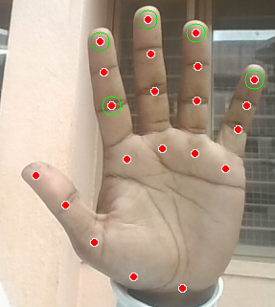
Controlling the Mouse Cursor Based on the Hand Gestures
The figure iterates through the detected hand landmarks and performs different actions based on the ID of the landmark. These actions include left-clicking, right-clicking, scrolling, and performing speech recognition and synthesis

Slide 8
components
Camera: The camera should be placed in a position where it can capture images of the user's hands.
Computer: The computer should be powerful enough to run the deep learning model and the software that translates the recognized hand gestures into mouse movements.
Software: The software should be installed on the computer.Experimental Results

Slide 9
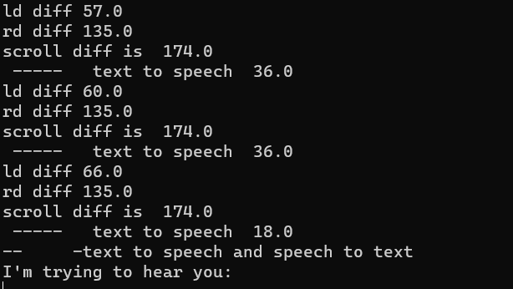
Sample output

Slide 10
Gesture Mapping
Landmark ID 8: Move the cursor.
Landmark ID 12: Perform a left-click.
Landmark ID 16: Perform a right-click.
Landmark ID 20: Scroll the mouse.
Landmark ID 6: Convert speech to text and text to speech.

Slide 11
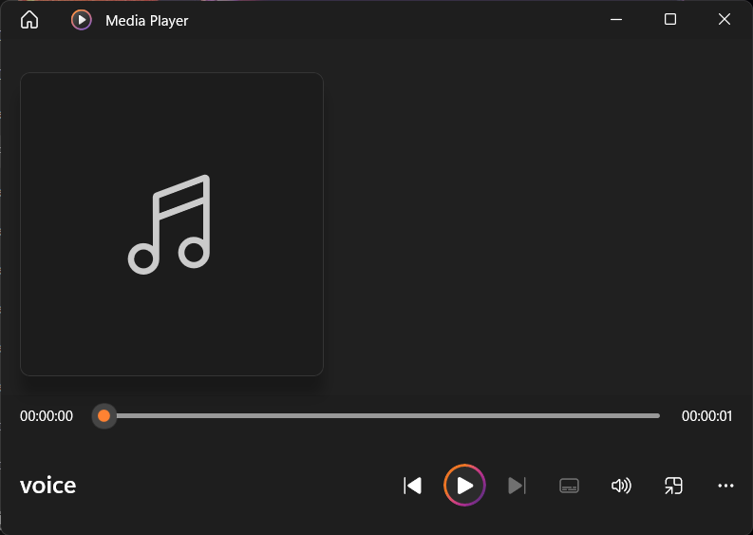
Playing audio file

Slide 12
Limitations
The proposed system has some limitations. One limitation is that the system requires a camera to capture images of the user's hands. This can be a problem in some situations, such as when the user is in a dark room or when the user is wearing gloves.
Another limitation is that the system is not yet fully automated. The user still needs to manually train the deep learning model and the software that translates the recognized hand gestures into mouse movements.

Slide 13
Future Work
The future work for the proposed system includes the following:
Developing a system that does not require a camera. This could be done by using a depth sensor or an inertial measurement unit (IMU).Automating the training of the deep learning model and the software that translates the recognized hand gestures into mouse movements.Making the system more user-friendly. This could be done by making the software easier to use and by providing more options for customizing the system.

Slide 14
Applications
Assistive technology for people with disabilities: The proposed system could be used as an assistive technology for people with disabilities. This could include people with spinal cord injuries, cerebral palsy, or other conditions that make it difficult to use a mouse.
Gaming: The proposed system could be used for gaming. This could include games that require hand gestures, such as virtual reality games or gesture-based games.
Virtual reality: The proposed system could be used for virtual reality. This could allow users to interact with virtual reality environments using their hands.
Industrial automation: The proposed system could be used for industrial automation. This could allow robots to be controlled using hand gestures.

Slide 15
THANK YOU

